Slide 1
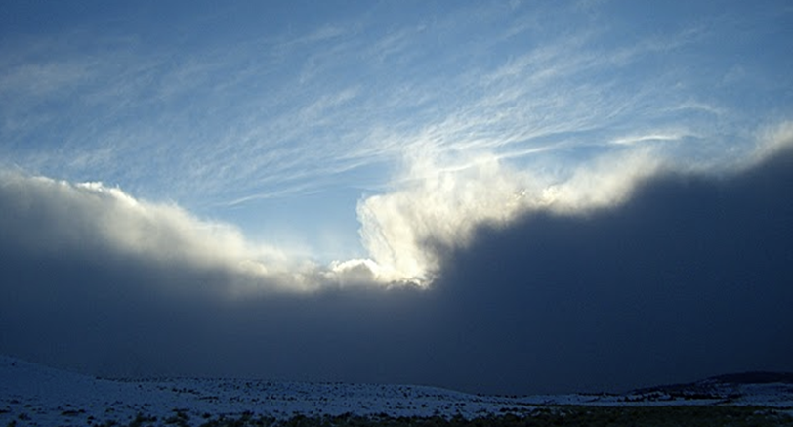

Level 1 Module 1
Topic 2A: The Avalanche Triangle – Weather Factors
Tahoe Backcountry Ski Patrol
January 2019
© 2019, Tahoe Backcountry Ski Patrol. This document may be freely used, modified or copied for any non-profit purpose as long as this copyright notice is maintained. Not reviewed by NSP. User has responsibility for determining fitness for use.

Slide 2
Weather Triangle
Precipitation
Temperature
Wind

Slide 3
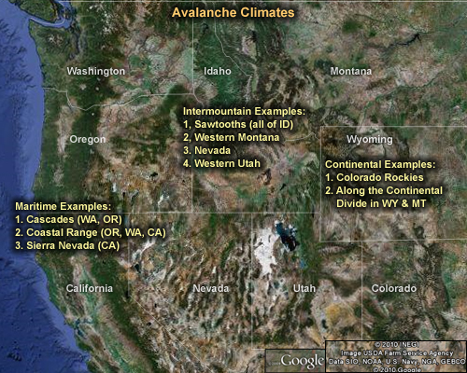
Snow climates
Maritime
Warm, wet
Deep snowpack
Relatively stable
Continental
Cold, dry
Thin snowpack
Potential for greater
snowpack instability
Intermountain

Slide 4
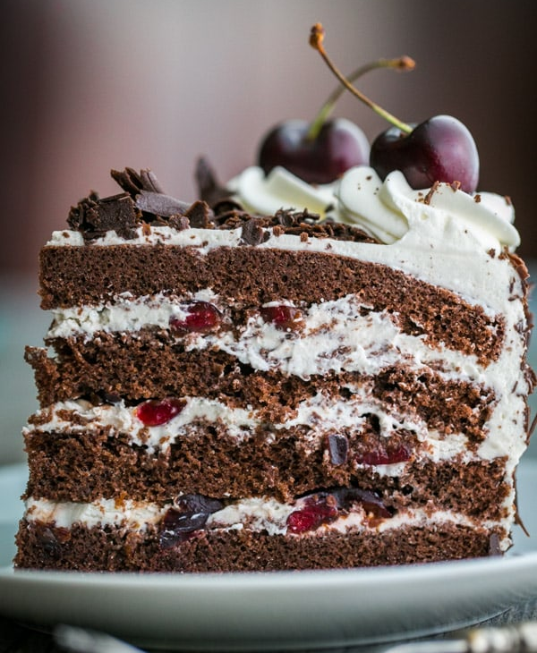
Weather effects on snowpack
Is the weather contributing to the avalanche hazard?
Recent weeks, earlier in the season
Right now
In the near future
Consider three key elements:
Temperature
Precipitation
Wind
Did weather increase/decrease the stability of the snowpack? What layers were formed?

Slide 5
Weather Triangle
Precipitation
Temperature
Wind

Slide 6
Temperature during Storm
Affects snow crystal type and snow
Warm storms produce denser more cohesive snow
Storm cycle matters:
Warm to cold storms produce right-side-up pack
Cold to warm storms produce upside-down pack
Rain could fall for above freezing temperatures

Slide 7
Temperature after Storm
Warmer temperatures:
Tend to stabilize the snowpack, but…
Rapid warming can have de-stabilizing effect (5C/3h)
Colder temperatures:
Tend to allow instabilities in the snowpack to persist, but…
Re-freezing of free water can significantly strengthen the snowpack
Surface temperature affects ability to bond later (e.g., wet, sticky versus icy sun crust)
Surface temperature depends on radiation

Slide 8


Radiation
In shade snow surface is colder than air above it
Shortwave “visible” radiation
Latitude, season, time of day
Slope angle, aspect
Longwave infrared radiation
Snow absorbs and emits effectively

Slide 9

Radiation
Thin clouds lead to warming of snow surface.
Mashed potatoes?
Shortwave “visible” radiation
Latitude, season, time of day
Slope angle, aspect
Longwave infrared radiation
Snow absorbs and emits effectively

Slide 10
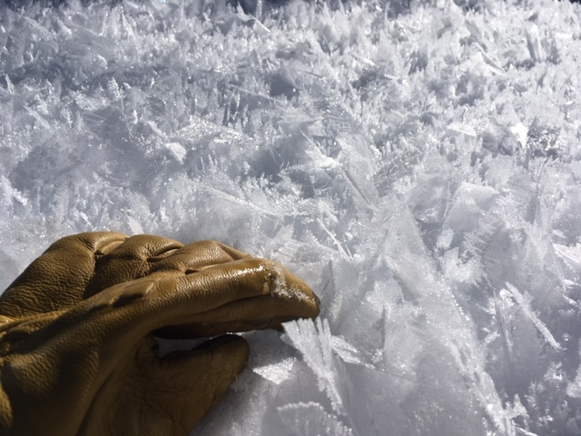

Radiation
Snow surface cools down. Surface hoar?
Shortwave “visible” radiation
Latitude, season, time of day
Slope angle, aspect
Longwave infrared radiation
Snow absorbs and emits effectively

Slide 11
Radiation
Snow surface cools much less.
Shortwave “visible” radiation
Latitude, season, time of day
Slope angle, aspect
Longwave infrared radiation
Snow absorbs and emits effectively

Slide 12
Wrap up …
Question: Why do facet layers typically tend to persist longer in Colorado than in the Sierras?
Continental snow climate
Cold temperatures
Shallow snow pack

Slide 13
Weather Triangle
Precipitation
Temperature
Wind

Slide 14
Effects of Wind
Uneven distribution of precipitation (deposition patterns)
Transport of already fallen snow
Fragmentation of crystals
Packing
Wind slab (loading rate larger than precipitation rate)
Scouring
Wind crust

Slide 15
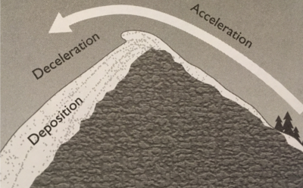
Wind speed
Wind accelerates up slopes (picks up snow) and decelerates down slope (drops snow)
Wind starts to transport snow at 5-10mph, most transport from 15-50mph
Notes:
(fig. 32, page 23 - Avalanche Handbook)

Slide 16
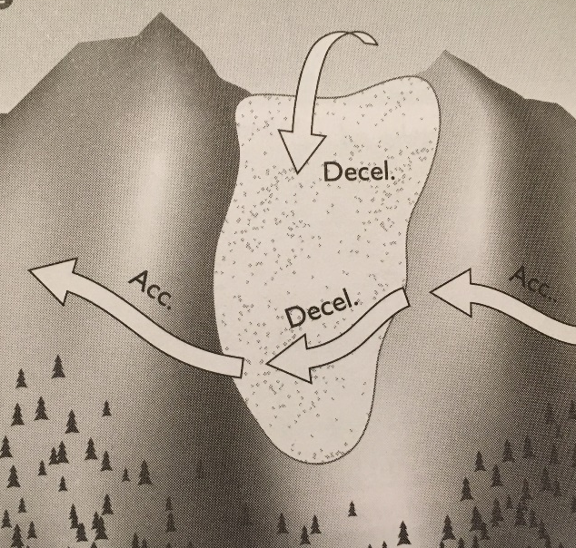
Wind Direction and Duration
Direction is key factor in determining wind loading patterns
Large-scale prevailing winds are predictable Q: Where to look?
Local wind direction highly dependent on surrounding terrain and daily weather
Cross-loading
Duration: the longer the wind event,
the more snow transported

Slide 17
Wind Deposition Patterns
Fragmentation: As snow crystals are transported, they are modified by collisions with other crystals
Lose crystals structure, become more rounded
Become denser and more cohesive
Cornices
Good evidence of wind deposition
Wind Slab
Built up snow on lee side of ridge
Particularly dangerous at changes in slope angle (convexity)

Slide 18
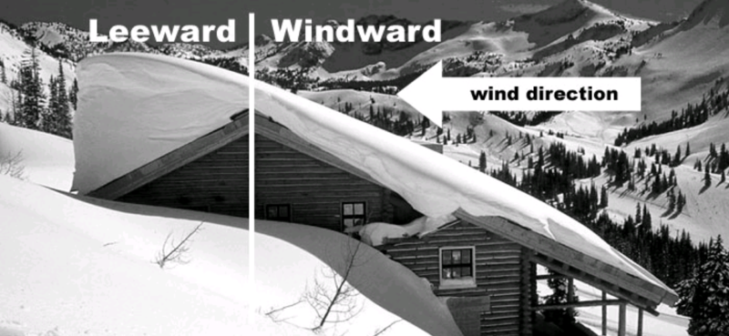
Wind direction

Slide 19
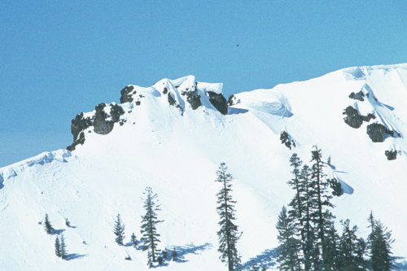
Wind Loading

Slide 20
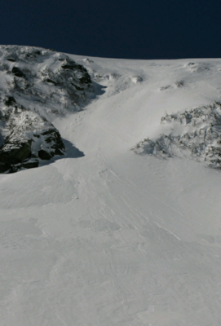
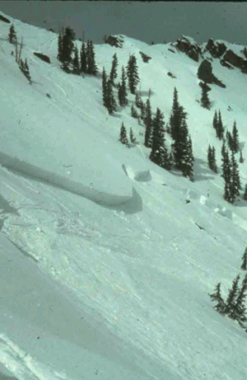
Wind Slab Deposition
Smooth, pillowy snow surface
Firm, chalky texture

Slide 21
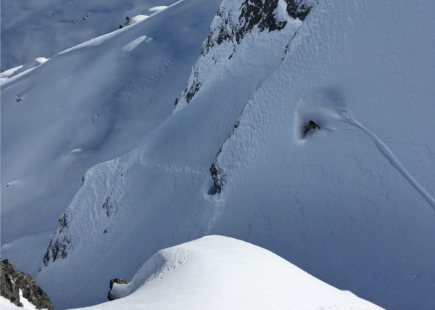
Temptations of a wind slab

Slide 22
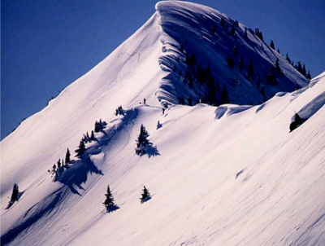
Cornice formation

Slide 23
Weather Triangle
Precipitation
Temperature
Wind

Slide 24
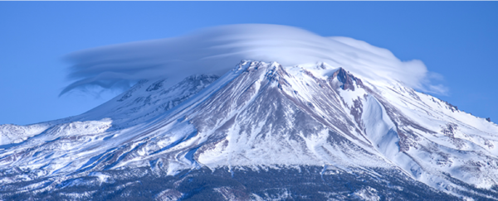
Orographic lifting
Lifting cools air by expansion (remember pressure decreases with height)
Air becomes saturated; condensation/precipitation kicks in
Descent warms air
Accounts for 50-70% of mountain precipitation

Slide 25
Precipitation
Key factors in precipitation effects:
Type of precipitation
Amount of precipitation
Snow density
Precipitation intensity
In general, the more rapidly the precipitation falls, the less time the snowpack has to adjust to the additional weight and the more likely is to avalanche.

Slide 26

Snow density
Density = Mass / Volume
Liquid water
Wet snow
Dry snow
10"
Density = 1000 kg/m3
200 kg/m3
50 kg/m3
Snow ratio = 1
5
20
Snow water= 10"
equivalent
2"
1/2"

Slide 27
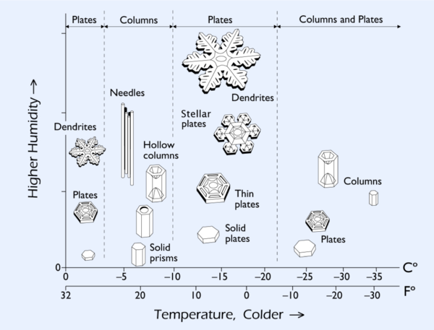
Snow particle types
Basic Form
Stellar
Dendrites
Columns
Needles
Plates
Irregular
Modified Form
Rime
Hail
Graupel
Sleet
Notes:
Graham considers this Level 2 material. Drop it

Slide 28
Snow density
In the cloud:
Snow particle type; “habit” (temp and humidity aloft)
Degree of riming (collision with supercooled liquid)
Below the cloud:
Sublimation and melting (acting first on edges and protruding structures)
Fragmentation (collision of crystals)
At the ground:
Wind fragmentation
Melting
Compaction by weight/Ageing by vapor diffusion

Slide 29
Snow density
High water content snow
Warm storms, roughly snow ratio 3-15 for falling snow
“Cohesive” snow; tends to form slabs
Low water content snow
Cold storms, roughly ratio 15-30 for falling snow
“Uncohesive” snow; tends to sluff or form sliding layers
Note:
Wind-deposited slab can have snow factor as low as 4-5

Slide 30
Snowfall factors
Precipitation Intensity vs Snowfall Intensity
Precip Intensity: rate at snow water equivalent is added to snowpack (SWE)
Difficult to measure!
Critical snowfall intensity (“rule of thumb”):
1” per hour (~2.5cm/hr)
Rapid loading if larger
Wrap-up: Which adds more weight to snowpack?
5” of snow ratio 5 or 10” of snow ratio 10?

Slide 31
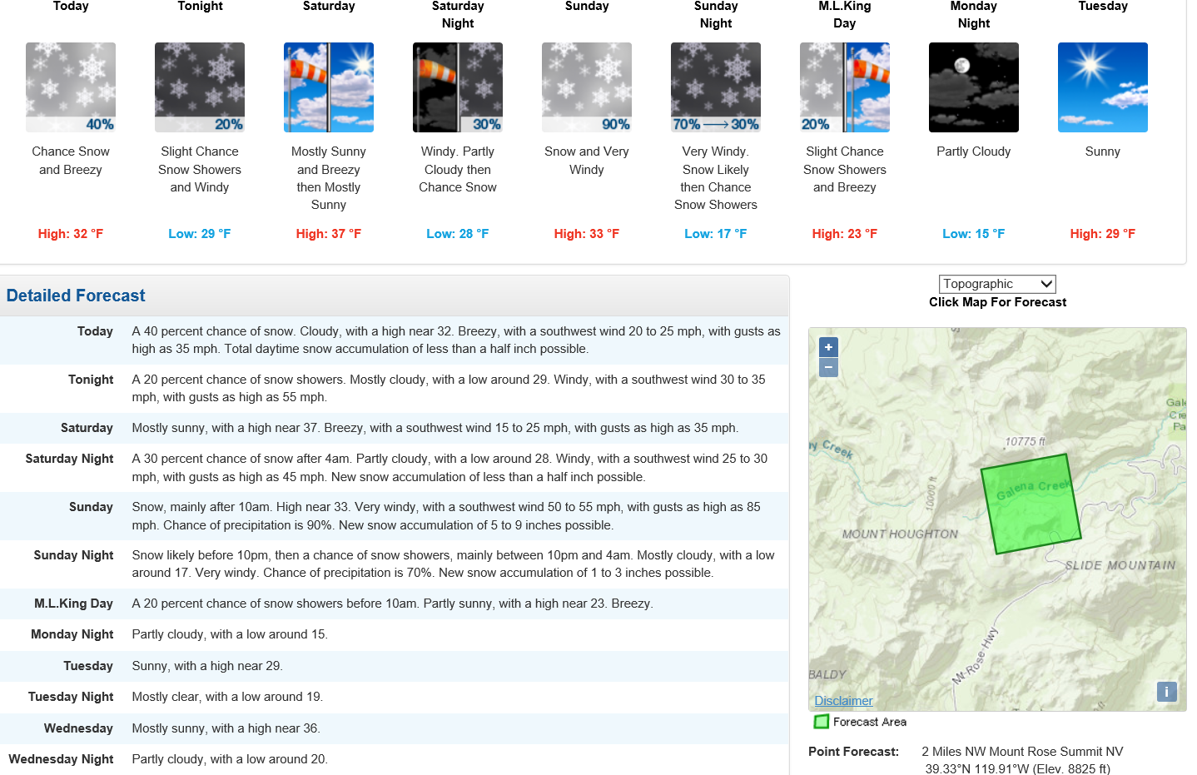
Weather Resources
NWS point forecast
Sierra Avalanche Center (Forecast summary and weather observations)
Eastern Sierra Avalanche Center
NWS Reno
Ski resorts

Slide 32
Wrap up: Critical weather conditions
Immediately after storms (rapid loading, storm slabs)
Cold to warm storms (upside-down snowpack)
During and after major wind events (wind slabs)
Prolonged cold (maintain instabilities)
Rapid warming/thaw (rapid transformation, no bonding)
Rain on snow event (rapid loading, percolation)
Prolonged periods of relative warmth (wet slab, spring)
Formation of crusts (rain crust, sun exposure, melt-freeze)

Slide 33
Topic 2A – Weather Factors
Concluding Objectives:
Describe how wind, temperature, and precipitation type affect snowfall.
Name and describe the typical snow characteristics of each U.S. snow climate zone
Identify critical weather conditions that tend to increase avalanche potential
Describe the relationship between precipitation density and intensity with respect to loading the snowpack.
Notes:
25 minutes
Topic 2: The Avalanche Triangle
Introduction
The avalanche triangle is a graphical way to organize and think about factors that contribute to avalanche hazard. The borders of the avalanche triangle represent factors that affect avalanche potential. The interior of the triangle represents consequences associated with human presence, which turns avalanche potential into avalanche hazard. Each subtopic below deals primarily with one leg of the triangle.
Though initially treated separately, students should become aware that all factors interact with each other in complex ways.
2A: Weather Factors (25 minutes)
Overview
Students should be able to express concepts of how temperature, wind and precipitation influence how the snowpack develops.
At this level, students are exposed to the effects (not causes) of observed or predicted weather. One possible exception is the role of radiation in warming and cooling the snow surface because it is not directly observable. Instructors need to ensure that this important factor is not overlooked.
The relationships between weather and snowpack will be developed in 2C: Snowpack Factors.
Key Terms
Climate
Density
Humidity
Loading
Orographic lifting
Precipitation
Precipitation intensity
Radiation
Relative humidity
Snow crystal
Vapor
Weather
Sample Set
Weather is often referred to as the architect of avalanches. It not only produces the snow in the first place, but it influences the snowpack in many other ways, even during “fair” weather. At this level, we will focus on observable weather events that serve as warnings of increasing avalanche potential.
Content
Temperature
Surface and atmospheric warming and cooling
Radiation
Short wave in
Long wave out
Conduction
Convection
Altitude and air temperature
Air temperature and snowpack temperature
Precipitation
Temperature and precipitation relationships
Effect on relative humidity and precipitation
Effect on precipitation types
Rain
Snow
Hail
Sleet
Precipitation Snow Classification (as opposed to snowpack grain structure)
Basic forms
Unbranched
Branched
Irregular
Special forms
Rime
Structure and appearance
Atmospheric conditions
Effects
Rime on snow crystals (graupel)
Rime on objects
Rime on snow surface
Frost (Surface hoar)
Structure and appearance
Atmospheric conditions
Effects
In the snowpack, simpler forms tend to pack closer together and bond with each other faster than more complex forms
Snowfall rate
Concept of loading
Snowfall Measurement
Storm total
Snowfall intensity (Based on SWAG but no codes)
Very light trace to ≈0.25” (0.5 cm)/h
Light ≈0.5 – 0.75” (1 - 2 cm)/h
Moderate ≈0.75 - 2” (2 - 5 cm)/h
Heavy ≈2 - 4” (5 - 10 cm)/h
Very heavy ≥4” (10 cm)/h
Snow Density
Definition
Relate to crystal type, size, moisture and packing
Denser snow adds greater weight load to snowpack than equal depth of less dense snow
Often reported as snow water equivalent (SWE), or simply “precipitation rate”.
Wind
Direction
Changes
Speed
Average
Gusting
Duration
Snow transport by wind
Evidence
Scouring
Pillows
Wind slabs
Critical speeds
Wind runs (fetch)
Significance
North American snow climate zones
Maritime
Intermountain
Continental
Avalanche cycles related to weather
During storms
Warm storms
Cold storms
Warm-to-cold storms
Cold-to-warm storms
After storms
Cooling trends
Prolonged cold
Warming trends
Prolonged relative warmth
Sources of Weather Data (advantages/disadvantages of each)
General weather reports (radio, other media)
Avalanche Center reports
Ski area reports
Remote weather observation stations (via internet)
Personal observations
Suggested Demonstrations/Student-Centered Activities
Give students examples of actual weather and avalanche data. Have them speculate on relationships.
Show photos of relative snow depths from windward & leeward aspects of the same ridge (from a single storm, or total depth) to illustrate the immediate and cumulative significance of wind transport.
Suggested Questions for Summary/Evaluation
What did you learn from this presentation? What else?
What is the difference between weather and climate?
What are the three basic snow climate zones in the U.S.? Where are they located? What are some characteristics of each zone?
Why is wind an important factor from an avalanche perspective?
What is snow density? Why is it important to be aware of? How can differences in density be estimated in the field?
What is the best way to estimate loading of a slope by precipitation? By wind?

